Slide 1
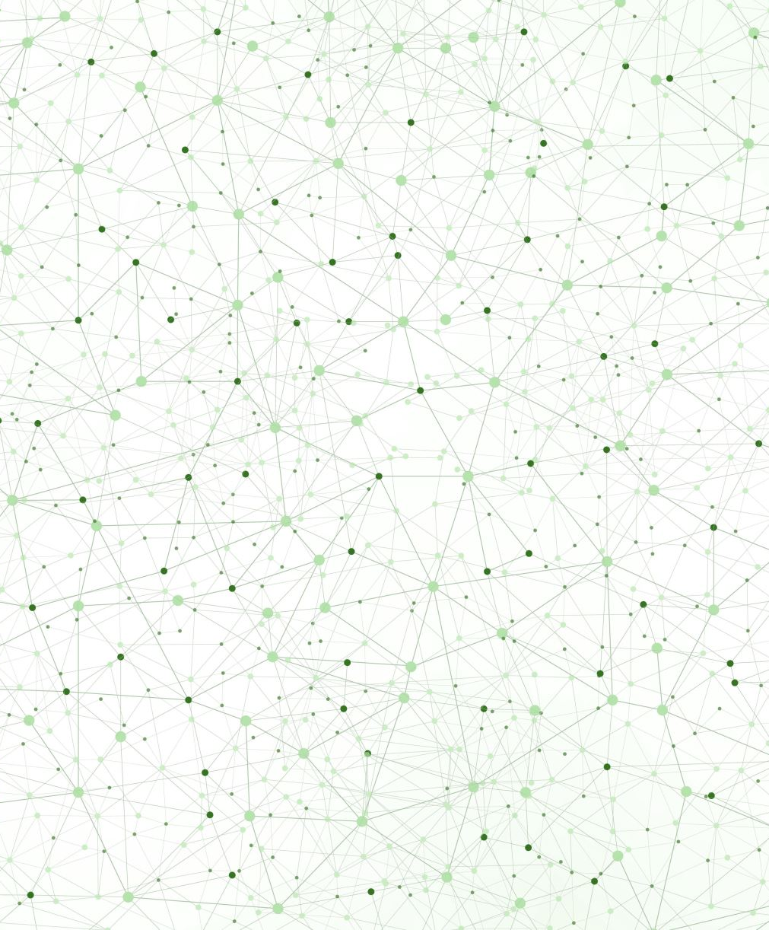
Mid-Term Presentation
Multilayer perceptron Interaction Detection
Edouard Dewaerheijd (i6341571)

Slide 2
1 Research Question

Slide 3





Research Question
How do regularization techniques and input noise influence the trajectory and stability of interaction recovery in MLPs, as measured against ground truth?
Why Interaction Recovery Matters
Beyond Linear XAI
Standard attribution gives one score per feature — misses non-additive dependencies like XOR logic
Explanation Fidelity
Including interactions raises explanation R² significantly vs. linear baselines; captures saturation effects
Debug Model Logic
Exposes spurious interactions — correlation vs. causation, data artifacts
High-Stakes Domains
Genomics epistasis, medical pathways — interactions are the language; simple attribution cannot capture them
Evaluating Regularization
Only way to verify if Dropout/L2 actually suppress spurious high-order interactions vs. genuine ones
Interaction recovery transforms XAI from importance ranking → functional map of model logic
[3] Tsang et al., 2018 [4] van Hilten et al., 2025 [8] Lengerich et al., 2022 [9] Janizek et al., 2021 [10] Tsang et al., 2018 [11] Guidotti et al., 2018 [12] Tsang et al., 2020 [13] Agarwal et al., 2022 [14] Montavon et al., 2018 [15] Arpit et al., 2017

Slide 4
2 Previous Research

Slide 5


Neural interaction Detection
NID framework (Tsang et al., 2017) — Two key observations about MLPs
⚡ Non-linear Activation Functions
🔗 Weight Encoding
Interactions arise from non-additive effects of activation functions (ReLU, Sigmoid)
Single features processed linearly cannot create interactions
Non-linearity is the source of feature coupling
Interaction paths are encoded directly in the weight matrices
Hidden units act as interaction detectors for connected inputs
Weight magnitude reflects interaction strength
How NID Works
1. Trace high-strength weights from input features to hidden units
2. Identify features sharing strong connections to the same hidden unit
3. Features with shared hidden units are flagged as interacting
[3] Tsang et al., 2018 [4] van Hilten et al., 2025 [5] Liu et al., 2020

Slide 6


Regularization Techniques
How each technique shapes what the MLP learns about feature interactions
✂ Dropout
⚖ L2 Regularization (Weight Decay)
Mechanism
Randomly removes units during training, sampling thinned sub-networks
Effect on Training
Forces robust features; prevents co-adaptation between units
Impact on Interactions
Selectively decays higher-order interactions — prioritizes simple, additive patterns first
Mechanism
Adds parameter norm penalty, shrinking weights toward zero
Effect on Training
Limits model capacity by penalizing large weight magnitudes
Impact on Interactions
Does not specifically target interaction order — applies uniformly to all weights
Strong L2 can cause instability, learning only constant functions
Key difference: Dropout selectively suppresses spurious high-order interactions that L2 cannot distinguish from genuine ones
[6] Srivastava et al., 2014 [7] Goodfellow et al., 2016 [8] Lengerich et al., 2022

Slide 7



Synthetic Data and GT Interactions
Synthetic Data
Ground Truth
Why Synthetic?
10 functions, each with 10 input features (x₁ ... x₁₀)
Designed with known mathematical structure
30 000 samples per function from uniform distribution
Controlled complexity across functions
Interactions = non-additive effects between features
Derived from functional decomposition of each f(x)
4–7 interaction groups per function
Groups range from pairs to 5-way interactions
Real datasets lack known ground truth interactions
Enables exact measurement of recovery rate and fidelity
Controlled comparison across regularization conditions
Reproducible benchmarking of NID methods
[1] Enouen & Liu, 2022 [2] Wong, Wang & Hryniowski, 2020

Slide 8
2 Methodology

Slide 9
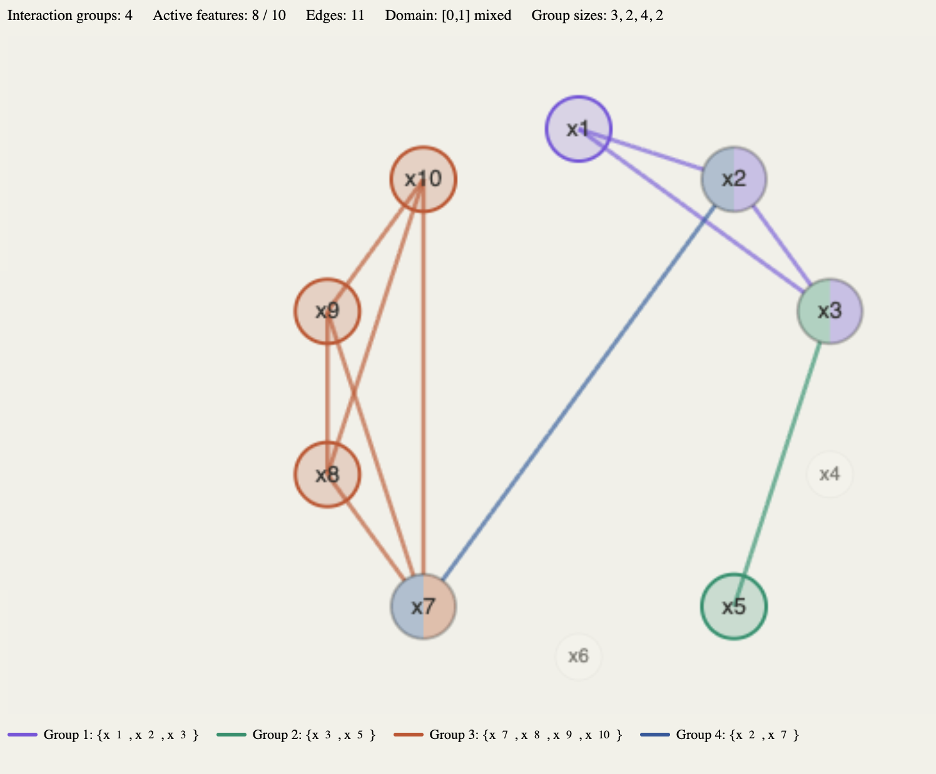
Function 1

Slide 10
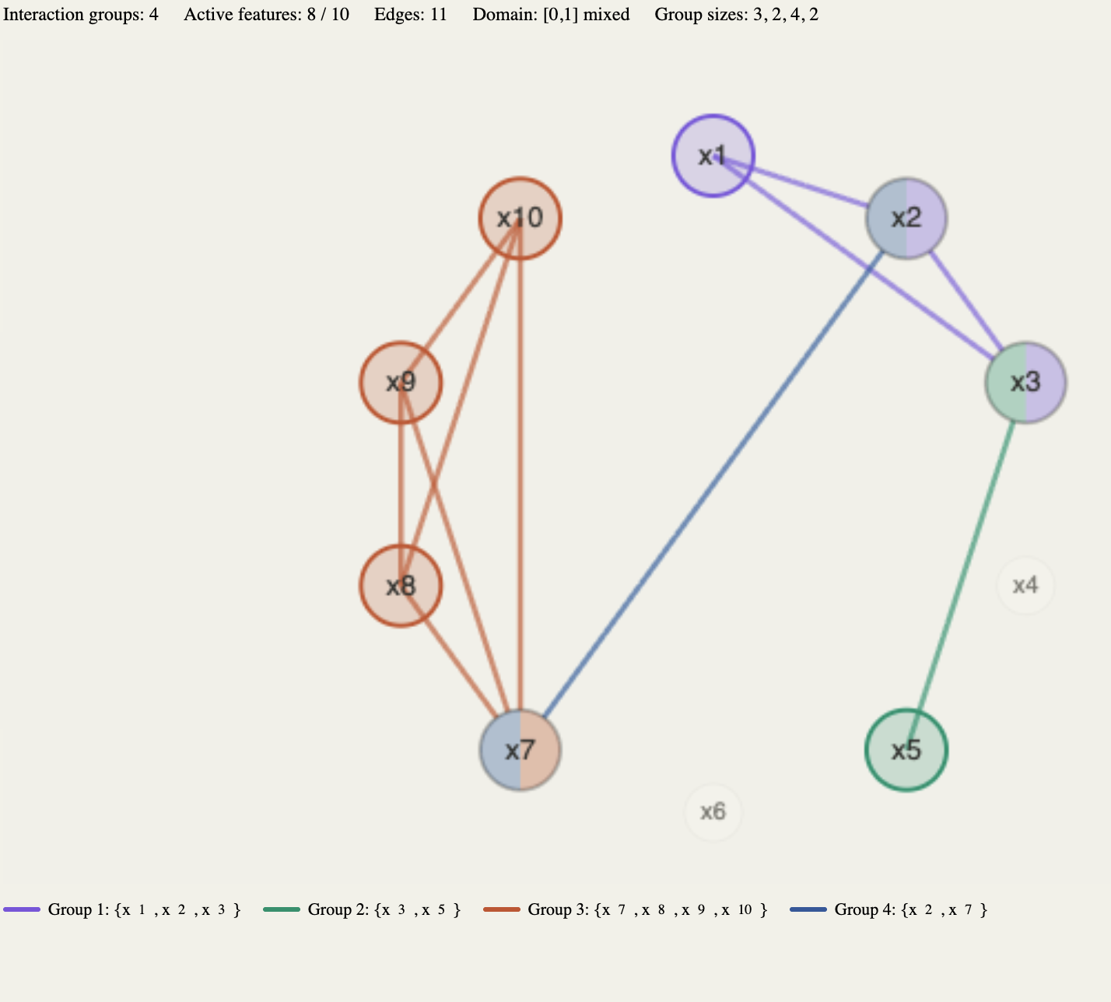
Function 2

Slide 11
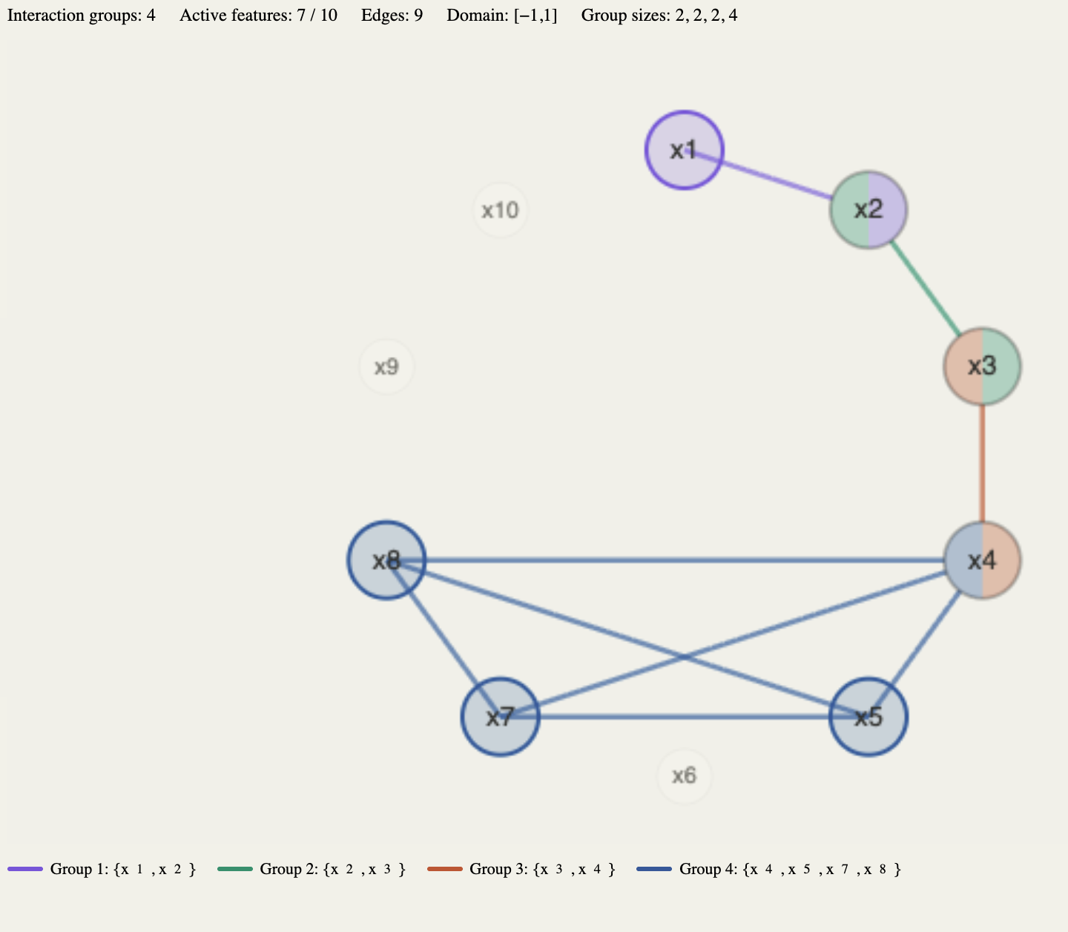
Function 3

Slide 12
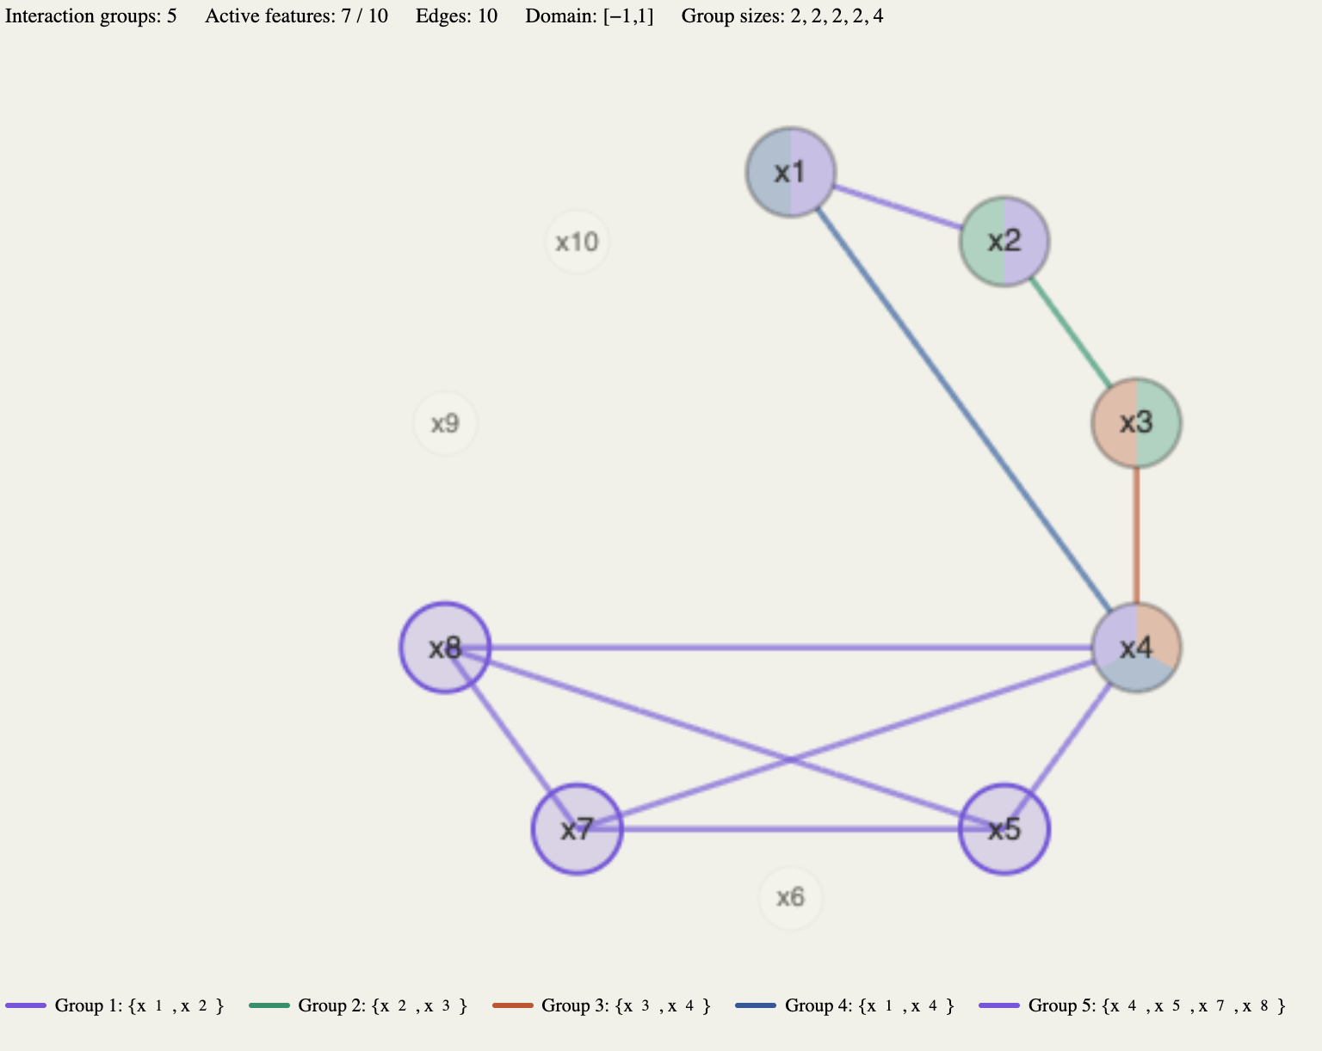
Function 4

Slide 13
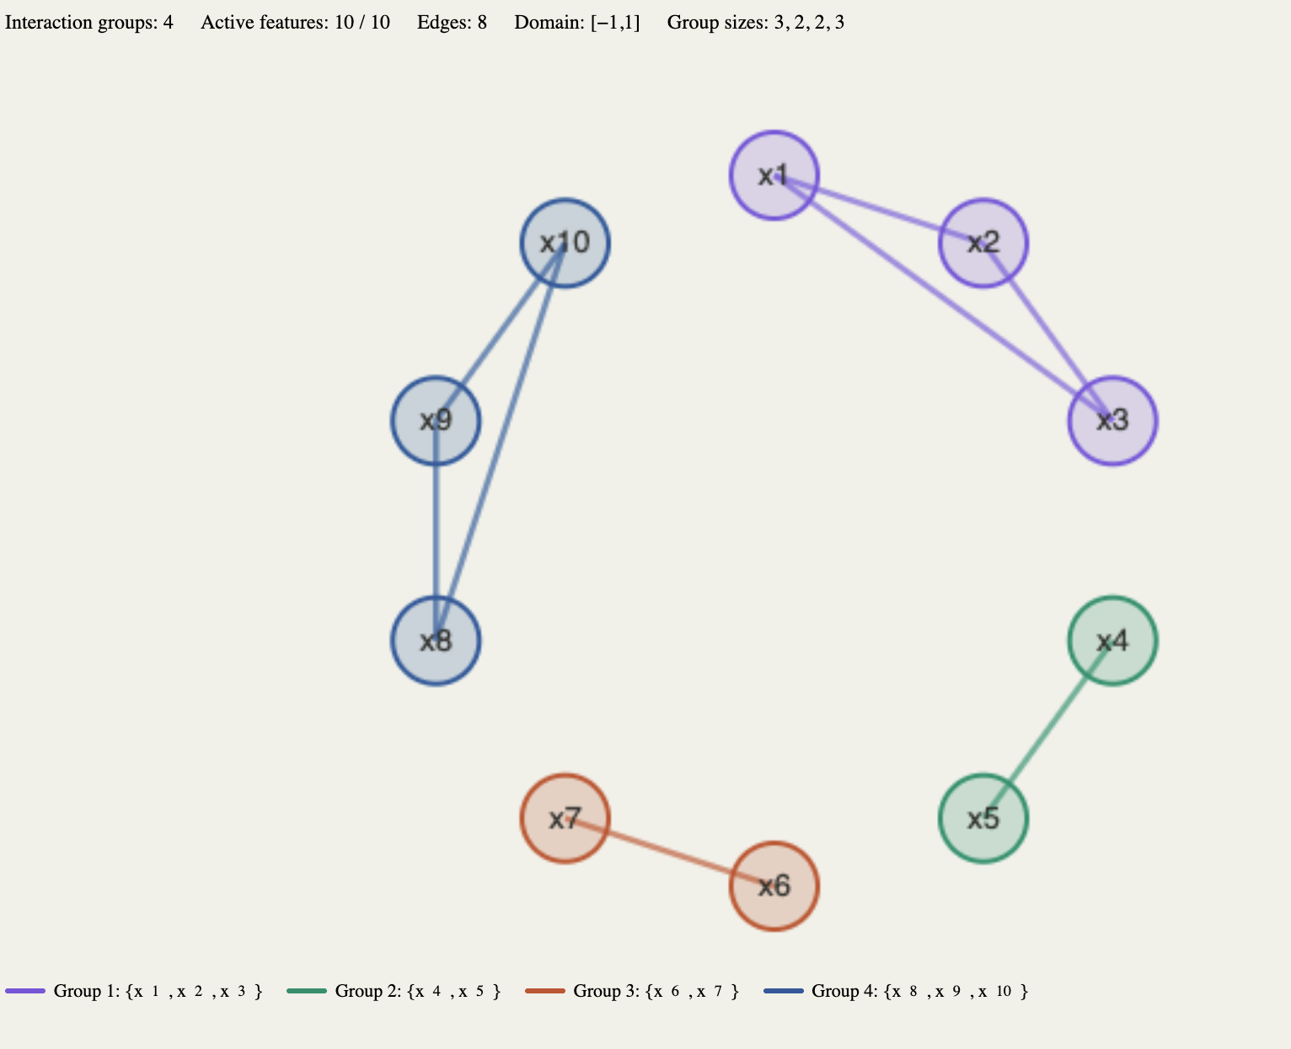
Function 5

Slide 14
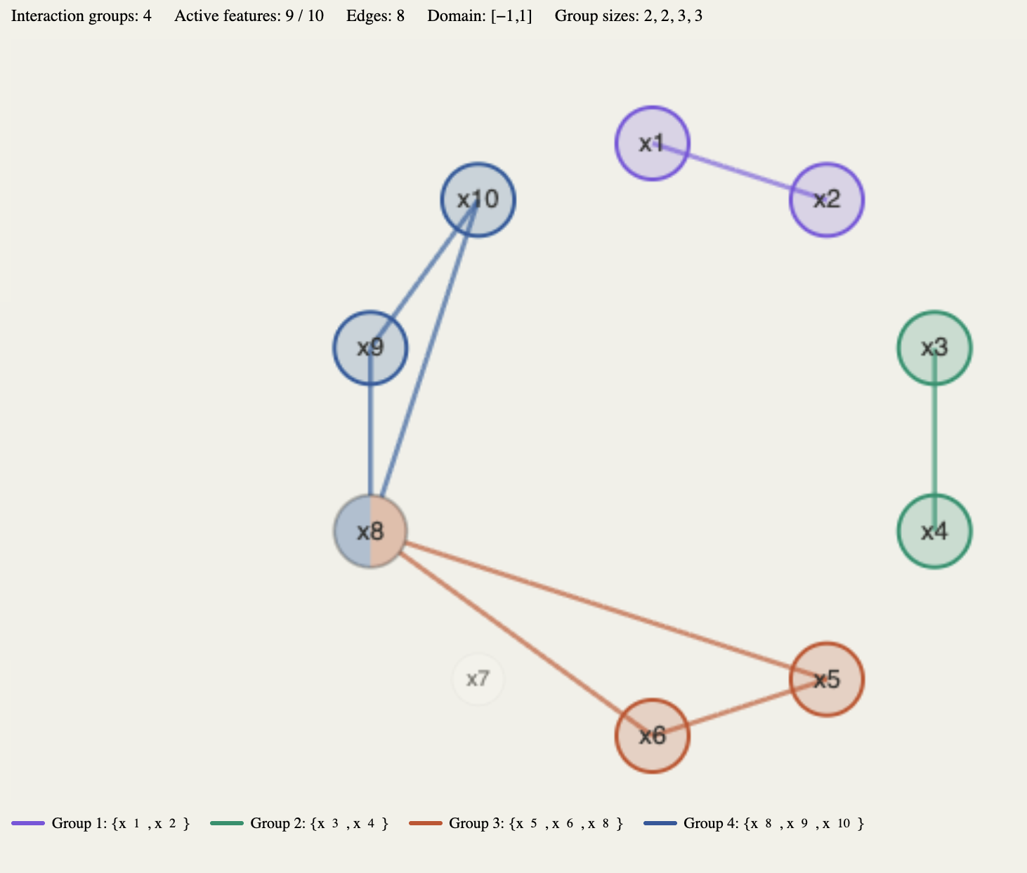
Function 6

Slide 15
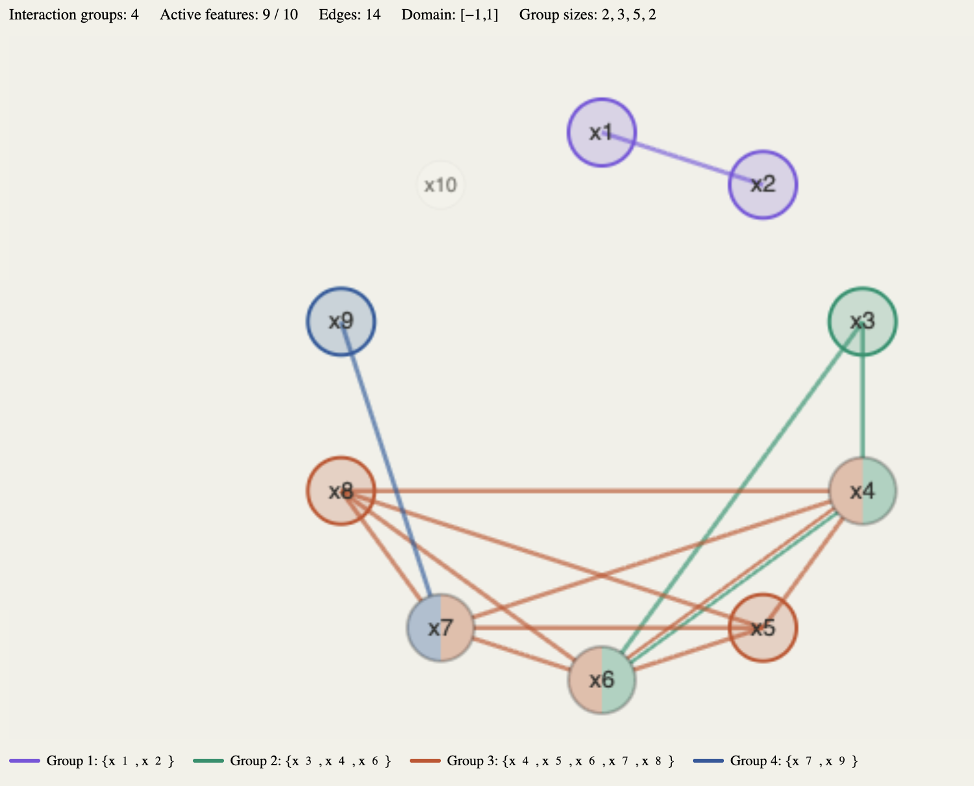
Function 7

Slide 16
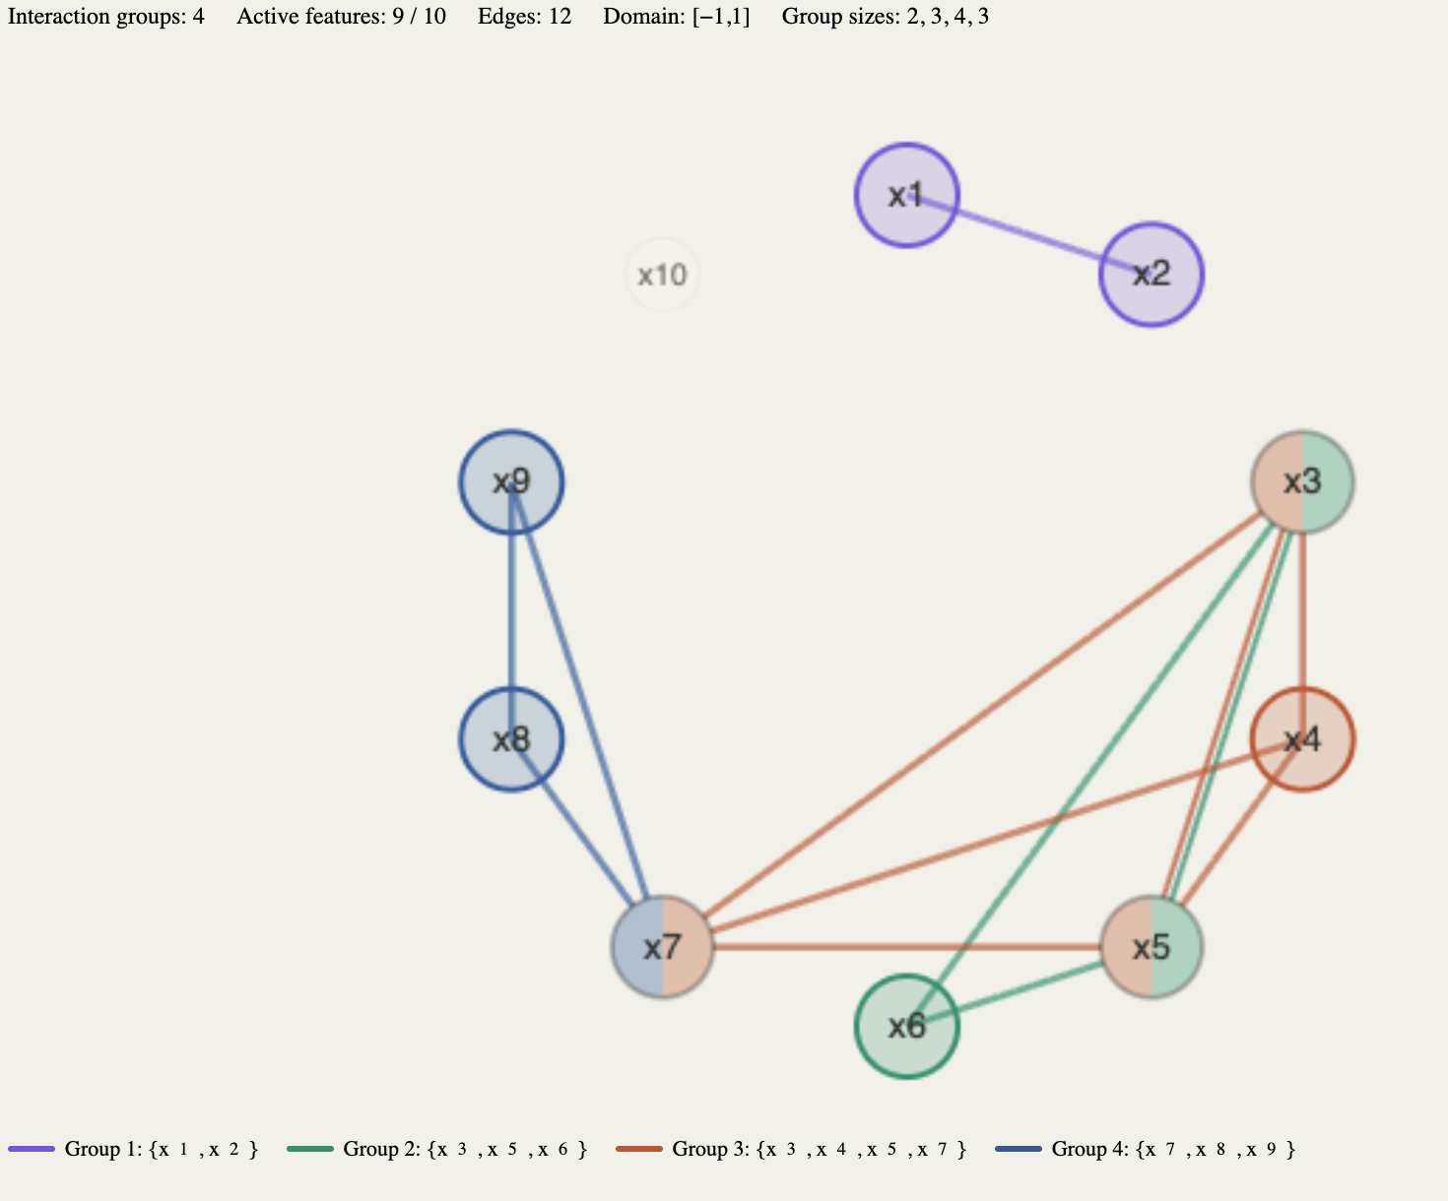
Function 8

Slide 17
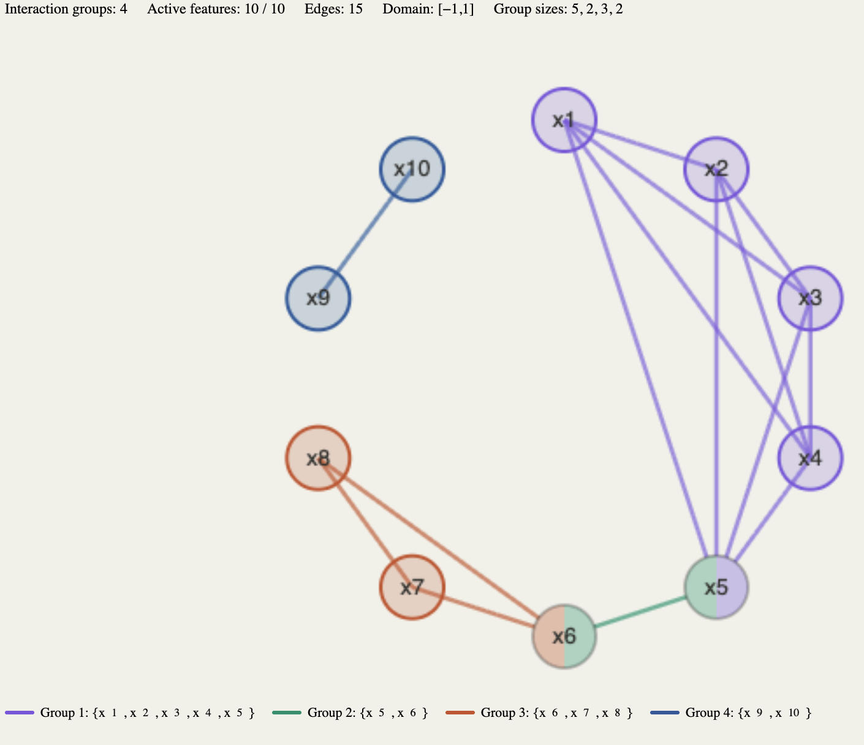
Function 9

Slide 18
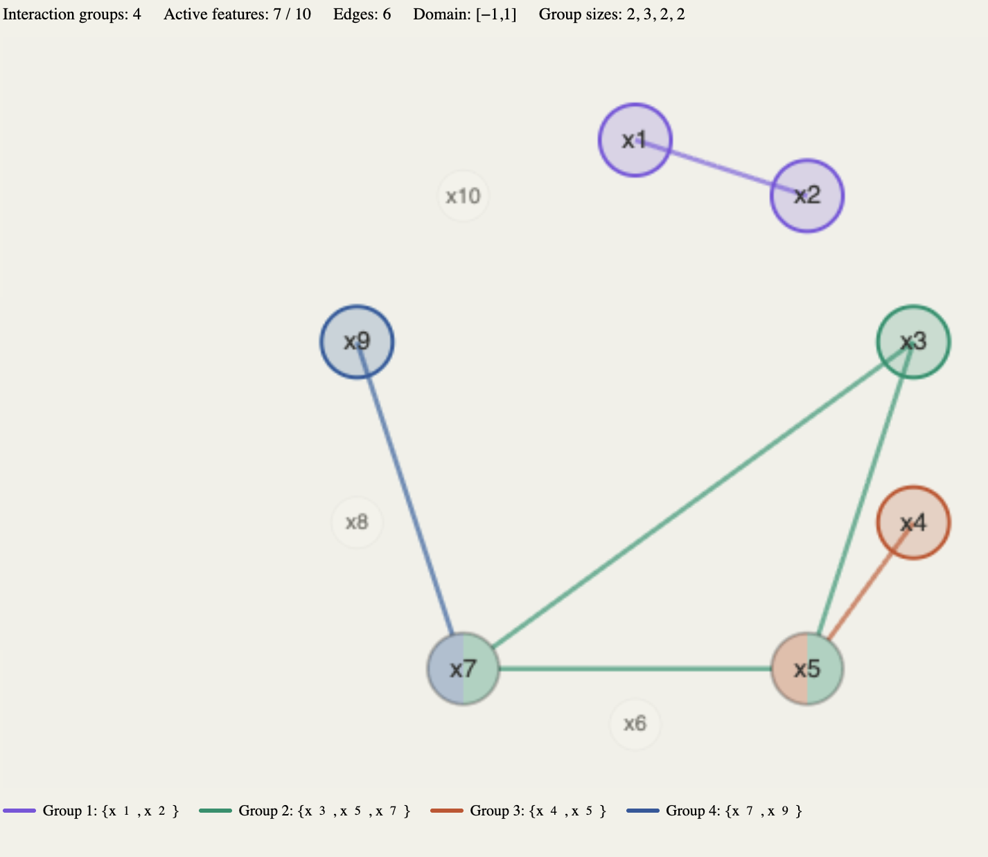
Function 10

Slide 19
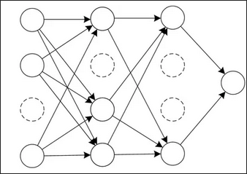



Methods
Input Noise
Optimizer
Regularization
Gaussian noise
Adam / SDG
Dropout
L2

Slide 20
Experimental Design
Full factorial: 5 noise levels × 4 regularization settings × 2 optimizers
Input Noise Level
Baseline
σ = 0.1
σ = 0.2
σ = 0.5
σ = 1.0
No regularization
A
S
Dropout (p = 0.2)
A
S
Weight Decay (L2)
A
S
Dropout + L2
A
S
Adam
SGD
Not tested
30 experiments
Each experiment runs on all 10 test functions → 300 total training runs

Slide 21
MLP Architecture
Interaction-only MLP — single branch, no main effect nets
Training
Observations : 30 000
Loss: MSE
Batch: 64 | Epochs: 100
LR: 0.01 | Val: 20%
Optimizers: Adam / SGD
x₁
x₂
ReLU
ReLU
Linear (MSE)
x₃
+ Dropout
+ Dropout
ŷ
Regularization
L1: 1e-4 (interaction weights)
L2: 0.1 (weight decay, conditional)
Dropout: 0.0 / 0.1 / 0.2 / 0.5
⋮
⋮
⋮
x₁₀
NID Weight Extraction
W₁: 10×64 | W₂: 64×64
W₃: 64×1 (output)
Interaction-only branch
Input
Hidden 1
Hidden 2
Output
10
64
64
1
Main effect nets disabled — all learned weights from interaction MLP only

Slide 22
AUROC Evaluation: Binary Classification Setup
Ground Truth
Interactions
{1,2,3}
{4,5,6}
{7,8,9}
Matching Logic
For each GT interaction:
Exact NID match? → score = strength
No match? → score = 0.0
Unmatched NID (not subset of GT):
→ negative sample
NID Detections
(with strengths)
{1,2,3} s=0.8
{4,5} s=0.6
{5,6,7} s=0.7
✓ Positive Samples (label=1)
GT {1,2,3} → score 0.8
GT {4,5,6} → score 0.0
GT {7,8,9} → score 0.0
One per GT interaction, always
✗ Negative Samples (label=0)
NID {5,6,7} → score 0.7
{4,5} excluded (subset of GT)
Unmatched + not subset of any GT
Output: scores = [0.8, 0.0, 0.0, 0.7] labels = [1, 1, 1, 0]

Slide 23
AUROC Computation: Concordant Pairs
AUROC = ( # concordant + 0.5 × # tied ) / ( # positives × # negatives )
Worked Example
Key Design Decisions
Positive scores (label=1)
[ 0.8, 0.0, 0.0 ]
Negative scores (label=0)
[ 0.7 ]
Exact matching only
Only credits NID detections that exactly match a GT interaction
Subset exclusion
Partial detections excluded from negatives (not penalized)
Count concordant pairs: positive score > negative score
0.8 > 0.7 → concordant ✓
Strength as confidence
NID strength = discrimination score for ranking
0.0 < 0.7 → discordant ✗
0.0 < 0.7 → discordant ✗
Fail-safe
Returns None if < 2 samples (no pos or no neg)
AUROC = 1 concordant / (3 × 1) = 0.333
AUROC = 0.5 random | AUROC = 1.0 perfect separation | Higher = NID better distinguishes real from spurious interactions

Slide 24
4 Experimental Results

Slide 25
General Findings
AUROC performance across all 300 training runs (30 configurations × 10 test functions)
MEAN AUROC
0.61
MEDIAN AUROC
0.55
MIN AUROC
0.00
MAX AUROC
1.00
What These Numbers Mean
Right-Skewed Distribution
Mean (0.61) > Median (0.55) suggests a few configurations achieve high AUROC while most are moderate
Full Range [0.0 – 1.0]
Some configurations achieve perfect detection while others perform at chance level — training setup matters enormously
Key Implication
Regularization and noise choices create a wide performance landscape — the next slides break down which factors drive this variance
AUROC = 0.5 is random guessing • AUROC = 1.0 is perfect interaction detection • n = 300 runs

Slide 26
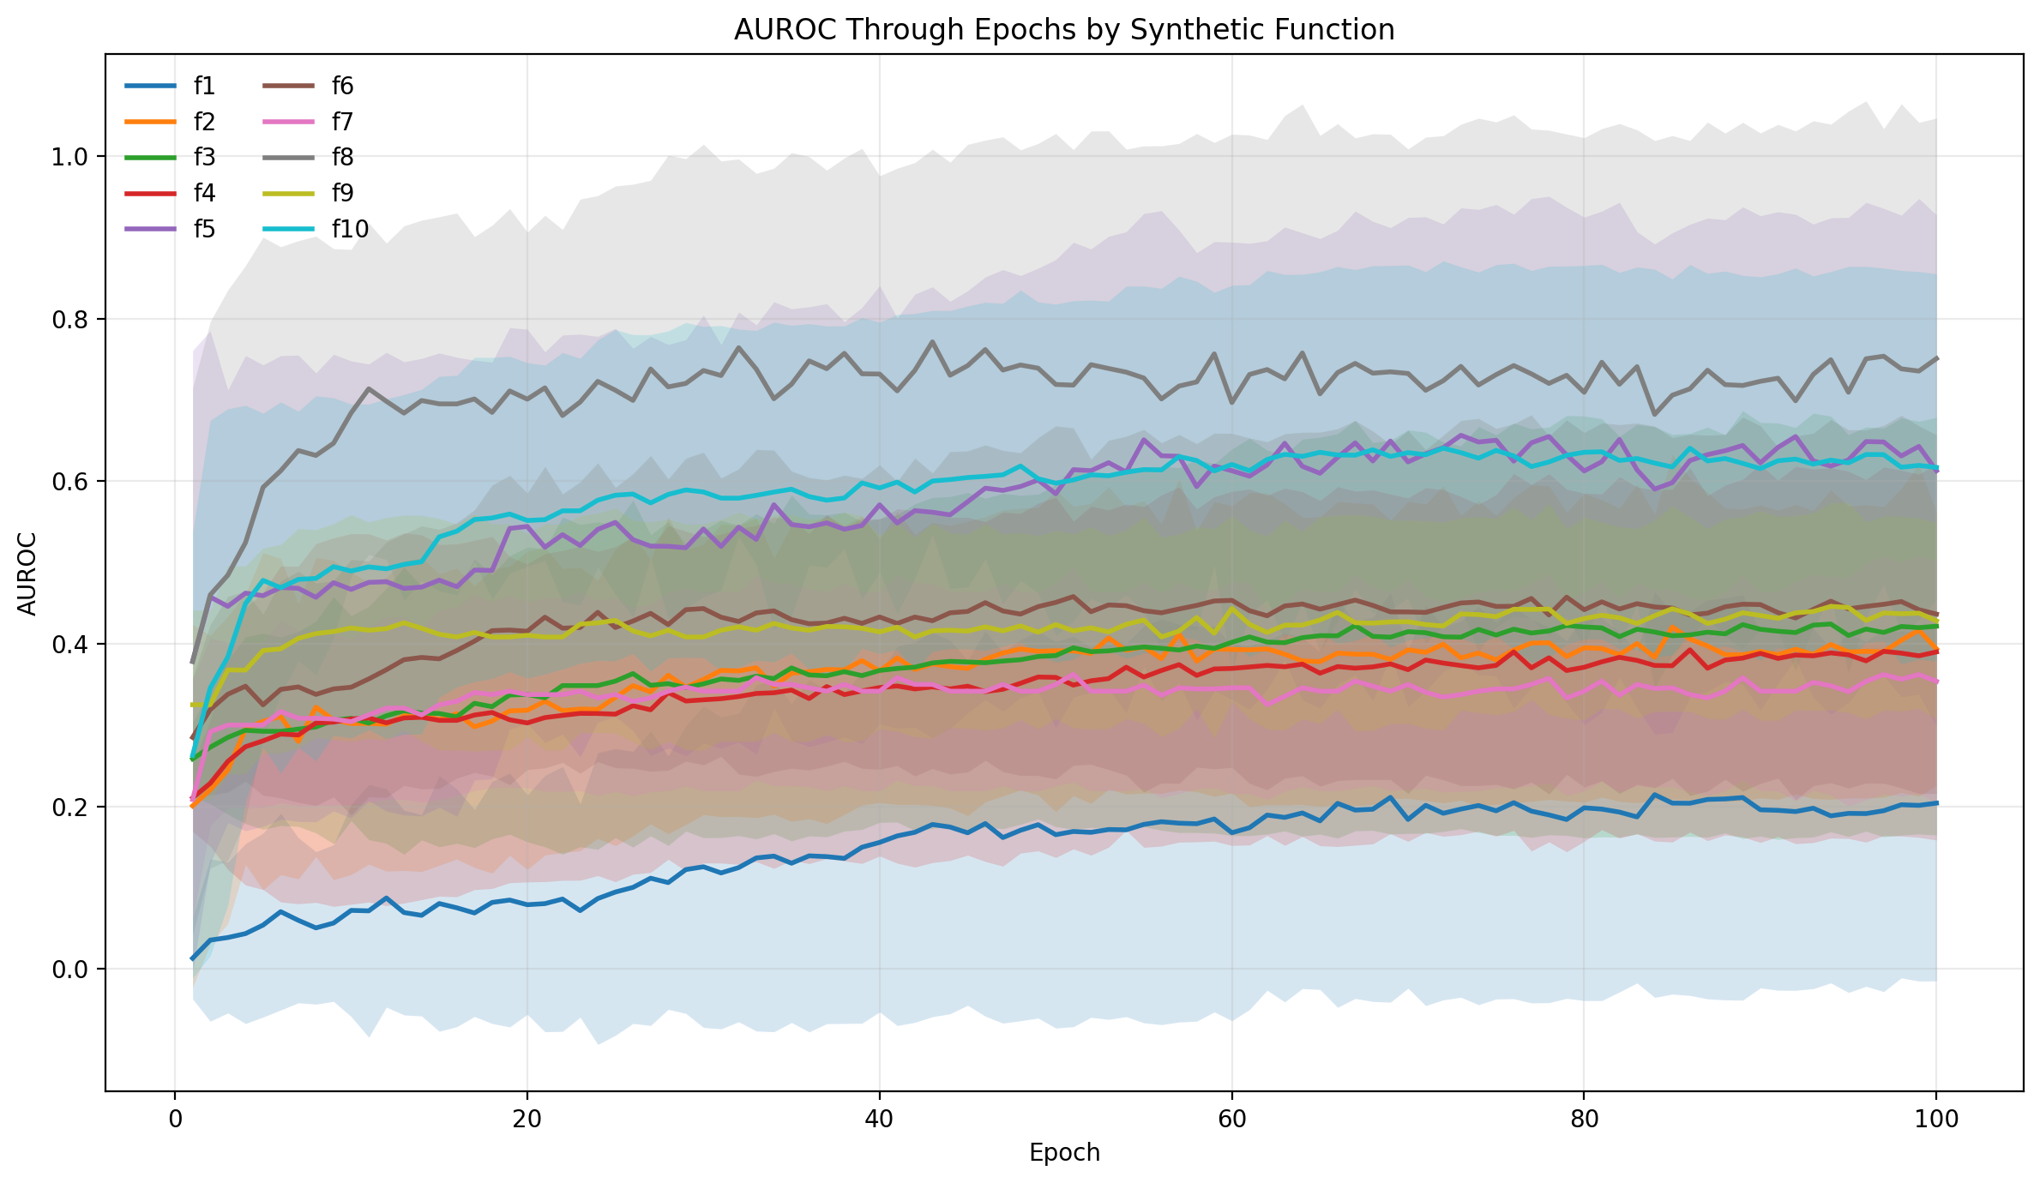
AUROC by Test Function
Function | Mean AUROC
f1 | 0.536
f2 | 0.609
f3 | 0.451
f4 | 0.453
f5 | 0.748
f6 | 0.543
f7 | 0.639
f8 | 0.825
f9 | 0.501
f10 | 0.828

Slide 27
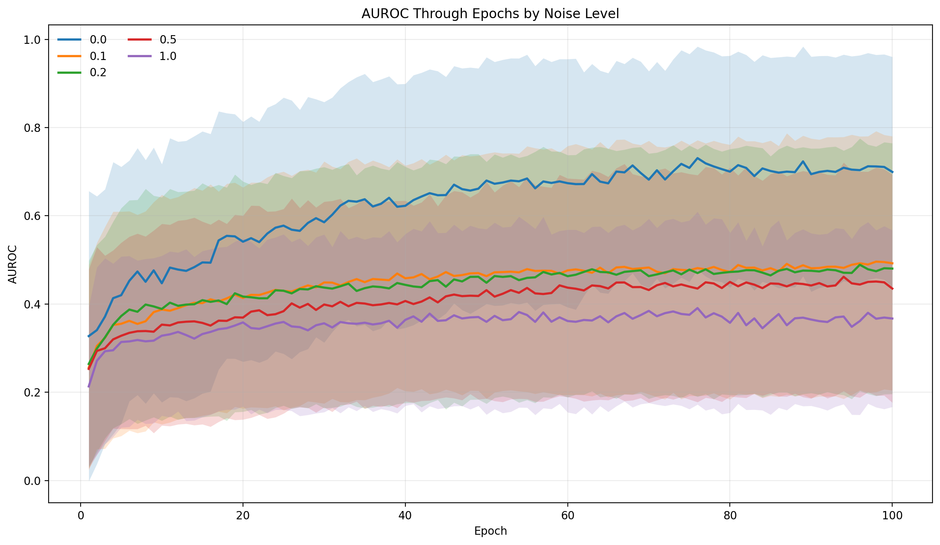
AUROC by Noise Level
Noise | Mean AUROC
0.0 | 0.81
0.1 | 0.67
0.2 | 0.61
0.5 | 0.59
1.0 | 0.49

Slide 28
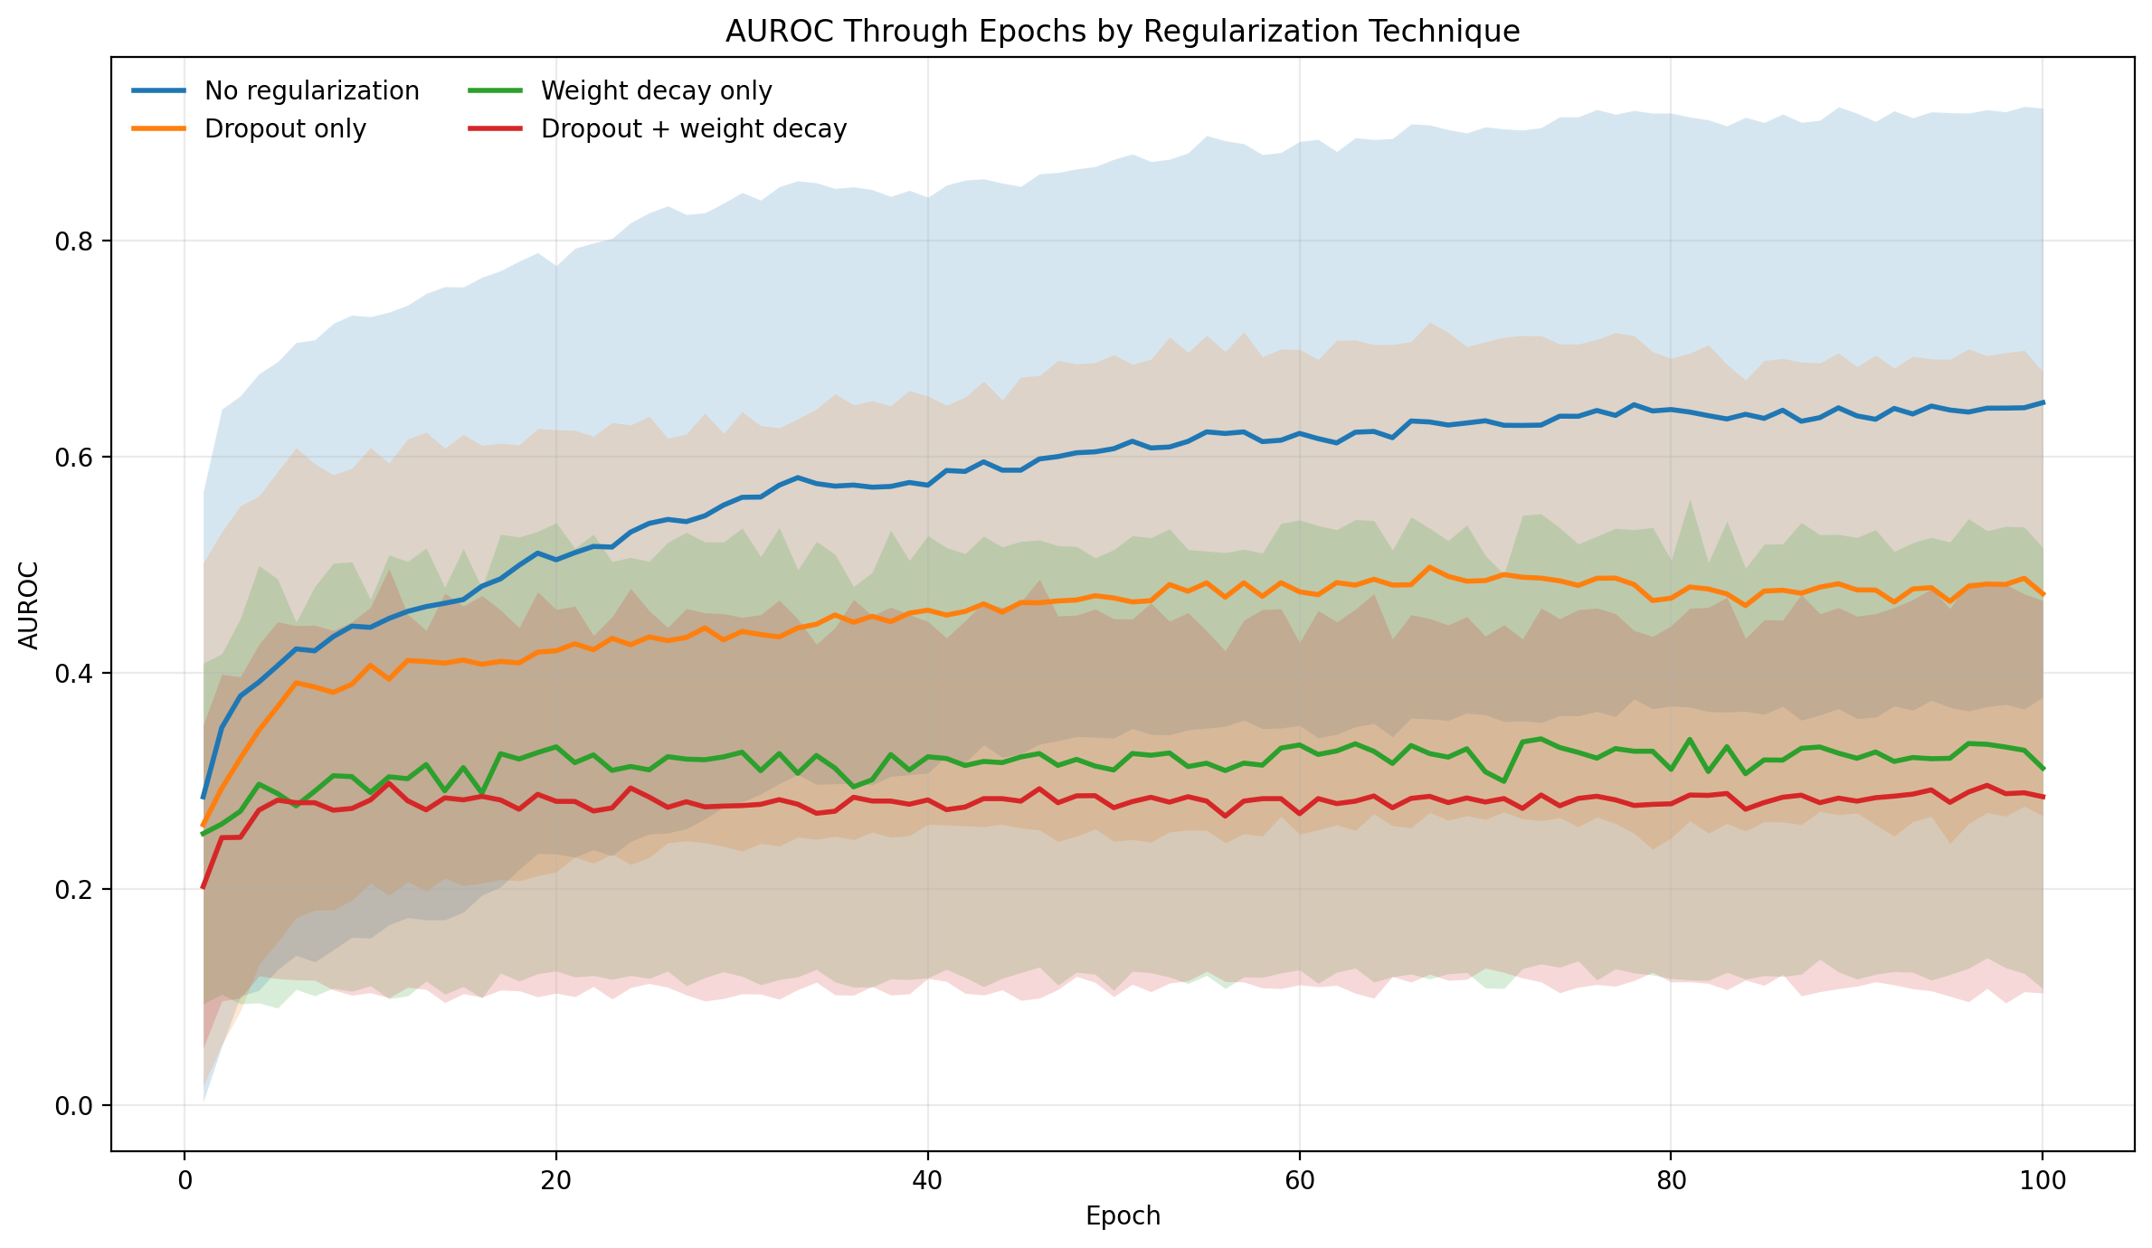
AUROC by Regularization Type
Setting | Mean AUROC
No regularisation | 0.73
Dropout only | 0.62
Weight decay only | 0.54
Dropout + weight decay | 0.48

Slide 29
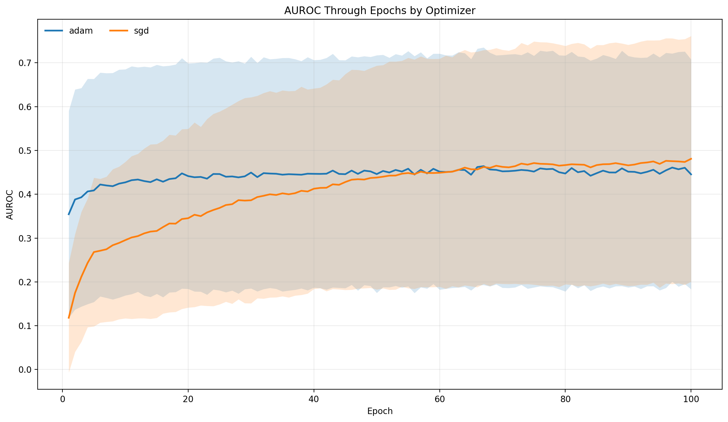
AUROC by Optimizer
Optimizer | Mean AUROC
Adam | 0.62
SGD | 0.60

Slide 30
Progress So Far
Phase 1
Phase 2
Phase 3
DONE
CURRENT
Foundation
Literature review
Problem formulation
Research question defined
Implementation
MLP training pipeline
NID interaction detection
AUROC evaluation framework
10 test functions + ground truth
Analysis & Writing
300 training runs completed
Recovery trajectory analysis
Stability metrics comparison
New experiments (samples, params)
More visualizations
10 functions
30 configs
300 runs
~80% done

Slide 31
Plan for Thesis / Next Steps
NOW
W1
W2
W3
W4
W5
W6
W7
W8
W9
W10
Missing experiments
2 wks
Retrain (more params)
2 wks
Vary observations
3 wks
Mathematical analysis
3 wks
Thesis writing
10 wks
⚠ Key risks: computational constraints · inconclusive results · scope adjustments

Slide 32
Bibliography and References
[1] Enouen, J., & Liu, Y. (2022). Sparse interaction additive networks via feature interaction detection and sparse selection. Advances in Neural Information Processing Systems, 35, 13908–13920. https://arxiv.org/abs/2209.09326
[2] Wong, A., Wang, X. Y., & Hryniowski, A. (2020). How much can we really trust you? Towards simple, interpretable trust quantification metrics for deep neural networks. arXiv. https://arxiv.org/abs/2009.05835
[3] Tsang, M., Cheng, D., & Liu, Y. (2018). Detecting statistical interactions from neural network weights. International Conference on Learning Representations. https://arxiv.org/abs/1705.04977
[4] van Hilten, A., Melograna, F., Fan, B., Niessen, W., van Steen, K., & Roshchupkin, G. V. (2025). Detecting genetic interactions with visible neural networks. Communications Biology, 8, Article 874. https://doi.org/10.1038/s42003-025-08157-x
[5] Liu, Z., Song, Q., Zhou, K., Wang, T.-H., Shan, Y., & Hu, X. (2020). Towards interaction detection using topological analysis on neural networks. Advances in Neural Information Processing Systems, 33.
[6] Srivastava, N., Hinton, G., Krizhevsky, A., Sutskever, I., & Salakhutdinov, R. (2014). Dropout: A simple way to prevent neural networks from overfitting. Journal of Machine Learning Research, 15, 1929–1958.
[7] Goodfellow, I., Bengio, Y., & Courville, A. (2016). Deep learning. MIT Press.
[8] Lengerich, B. J., Xing, E. P., & Caruana, R. (2022). Dropout as a regularizer of interaction effects. In G. Camps-Valls, F. J. R. Ruiz, & I. Valera (Eds.), Proceedings of the 25th International Conference on Artificial Intelligence and Statistics (Proceedings of Machine Learning Research, Vol. 151). PMLR. https://proceedings.mlr.press/v151/lengerich22a.html
[9] Janizek, J. D., Sturmfels, P., & Lee, S.-I. (2021). Explaining explanations: Axiomatic feature interactions for deep networks. Journal of Machine Learning Research, 22(104), 1–54. https://www.jmlr.org/papers/v22/20-1223.html
[10] Tsang, M., Sun, Y., Ren, D., & Liu, Y. (2018). Can I trust you more? Model-agnostic hierarchical explanations. arXiv. https://arxiv.org/abs/1812.04801
[11] Guidotti, R., Monreale, A., Ruggieri, S., Turini, F., Giannotti, F., & Pedreschi, D. (2018). A survey of methods for explaining black box models. ACM Computing Surveys, 51(5), Article 93, 1–42. https://doi.org/10.1145/3236009
[12] Tsang, M., Cheng, D., Liu, H., Feng, X., Zhou, E., & Liu, Y. (2020). Feature interaction interpretability: A case for explaining ad-recommendation systems via neural interaction detection. International Conference on Learning Representations. https://arxiv.org/abs/2006.10966
[13] Agarwal, C., Krishna, S., Saxena, E., Pawelczyk, M., Johnson, N., Puri, I., Zitnik, M., & Lakkaraju, H. (2022). OpenXAI: Towards a transparent evaluation of post hoc model explanations. Advances in Neural Information Processing Systems, 35.
[14] Montavon, G., Samek, W., & Müller, K.-R. (2018). Methods for interpreting and understanding deep neural networks. Digital Signal Processing, 73, 1–15. https://doi.org/10.1016/j.dsp.2017.10.011
[15] Arpit, D., Jastrzębski, S., Ballas, N., Krueger, D., Bengio, E., Kanwal, M. S., Maharaj, T., Fischer, A., Courville, A., Bengio, Y., & Lacoste-Julien, S. (2017). A closer look at memorization in deep networks. In D. Precup & Y. W. Teh (Eds.), Proceedings of the 34th International Conference on Machine Learning (Proceedings of Machine Learning Research, Vol. 70, pp. 233–242). PMLR. https://proceedings.mlr.press/v70/arpit17a.html

